Slide 1
Digital Portfolio
STUDENT NAME: JAYASHREE V
REGISTER NO AND NMID:293212402034
DEPARTMENT: BCA Computer Application
COLLEGE: Vidhya Sagar Women's College/MADRAS UNIVERSITY

Slide 2
PROJECT TITLE
DIGITAL PORFOLIO

Slide 3


AGENDA
Problem Statement
Project Overview
End Users
Tools and Technologies
Portfolio design and Layout
Features and Functionality
Results and Screenshots
Conclusion
Github Link
3/21/2024 Annual Review

Slide 4

PROBLEM STATEMENT
In the current digital era, professionals, students, and organizations increasingly rely on digital portfolios to showcase their skills, projects, and achievements.
However, many existing platforms lack personalization, interactivity, and centralized management, making it difficult for users to effectively present their capabilities and for recruiters or clients to evaluate them efficiently.

Slide 5

PROJECT OVERVIEW
A digital portfolio is a curated online collection of work, skills, and achievements used by professionals and students to demonstrate their expertise to potential employers, clients, or collaborators.
It acts as a comprehensive, dynamic, and easily accessible platform for showcasing accomplishments, building a personal brand, and providing evidence of capabilities.

Slide 6

WHO ARE THE END USERS?
Employers / Recruiters->To evaluate your skills, experience, and projects.
Clients / Customers To assess your work quality and previous projects.
Academic Institutions ->To review your academic achievements, certifications, and projects.

Slide 7

TOOLS AND TECHNIQUES
Website Builders :Wix, WordPress, Squarespace, Google
Coding & Development Tools :HTML, CSS, JavaScript, Bootstrap, React
Techniques: Bootstrap framework, CSS Flexbox/Grid
Responsive Web Design Ensures the portfolio looks good on desktops, tablets, and mobiles.

Slide 8
POTFOLIO DESIGN AND LAYOUT
Design Principles:
Simplicity: Keep the design clean and avoid unnecessary clutter.
Consistency: Use uniform colors, fonts, and layouts throughout the portfolio.
8

Slide 9
FEATURES AND FUNCTIONALITY
navigation and sharing across different platforms, content that is mobile-friendly and visually appealing, and the ability to demonstrate growth and reflection over time.
The primary goal is to serve as a persuasive, personal marketing tool for potential employers or clients, highlighting unique capabilities and creating a positive, lasting impression.the ability to demonstrate growth and reflection over time.
The primary goal is to serve as a persuasive, personal marketing tool for potential employers or clients, highlighting unique capabilities and creating a positive, lasting impression.

Slide 10
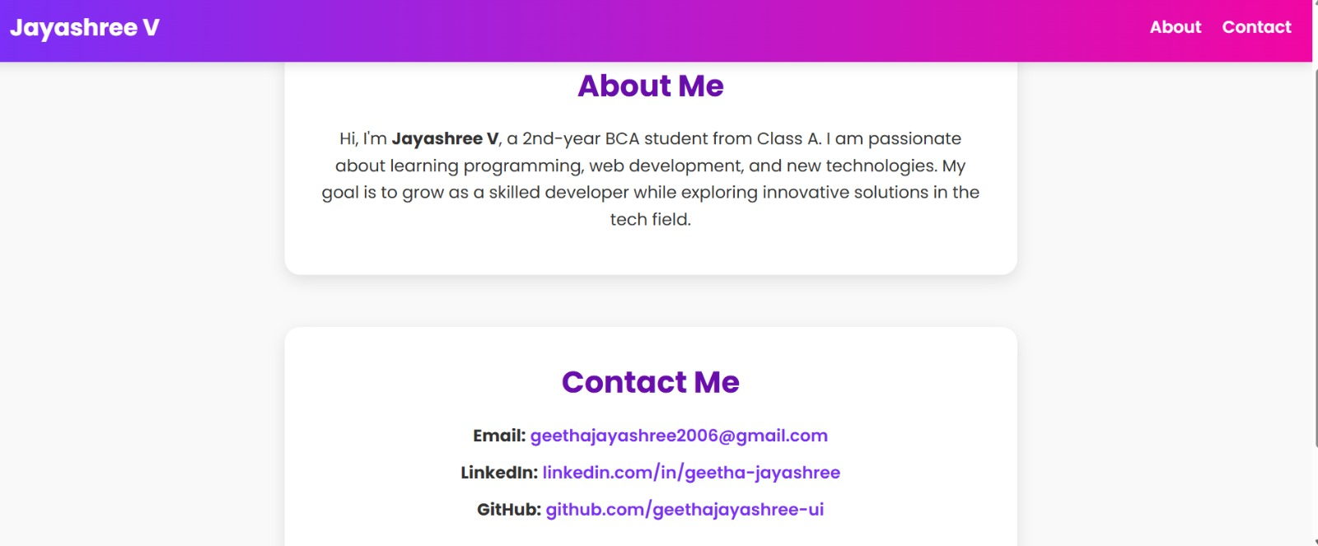

RESULTS AND SCREENSHOTS
3/21/2024 Annual Review
10

Slide 11
CONCLUSION
A digital portfolio is an essential tool for showcasing an individual’s skills, achievements, experiences, and projects in a structured and visually appealing way.
It acts as a professional representation of one’s abilities and helps in building a strong personal brand.
11

Slide 12
GITHUB LINK

